Slide 1
VERA Training: Excore Modeling
VERA Training
February 14, 2019
Oak Ridge National Laboratory

Slide 2
Why do we need an Omnibus input to perform excore calculations?
You can model the core in great detail using VERA
There is no standard geometry for excore features
Needs extensible models for any system
Works seamlessly with VERA core specifications
Excore models using Omnibus can be set up to perform
coupon fluence calculations
vessel fluence calculations above/below beltline region
detector response calculations
bioshield flux/fluence calculations
These excore calculations and quantities of interest are performed and tallied by Shift, a Monte Carlo Code

Slide 3
Training Objectives
Give a comprehensive overview of input pertinent to excore calculations
Review simple omnibus excore input and output

Slide 4
Excore Modeling and Simulation
Excore Omnibus input can be set up from the outer radius of the inner barrel to any radial region of interest
Setting up an Omnibus input can be as complicated or easy as the geometry in the region the user is interested in studying
Learning curve in setting up Omnibus input is not too steep if the user is familiar with KENO geometry
Works with the idea of geometric primitives combined with unions and intersections
The process enables the user to set up a detailed core model using VERA and insert this model into an Omnibus geometry for the excore problem

Slide 5
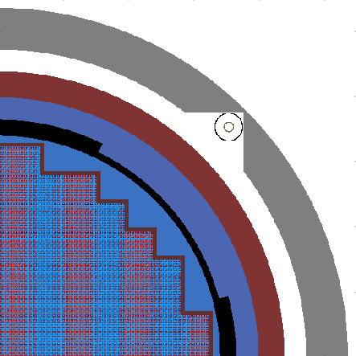
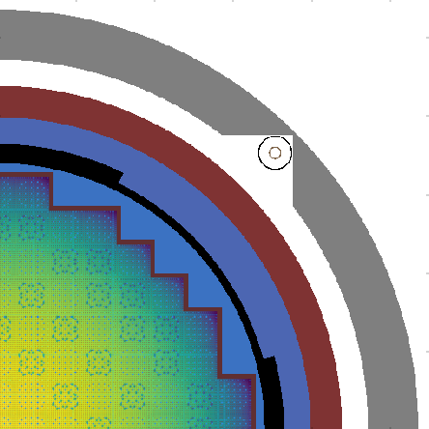
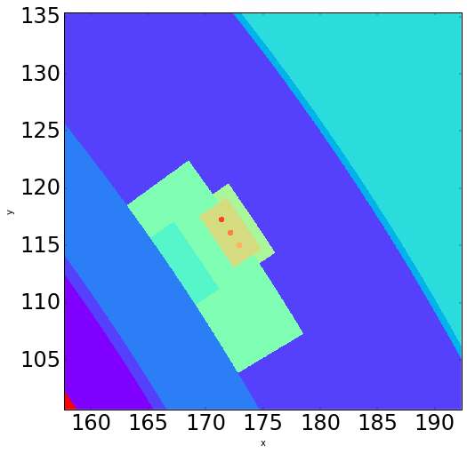
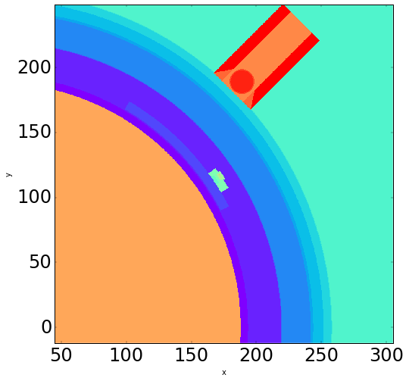
Examples of Omnibus Geometry We Have Set Up
Left: Integrated in-core and excore Harris Model
Right: Fission Source
Left: Coupons in Watts Bar Model
Right: Single Surveillance Capsule and Power Range Detector in Watts Bar Model

Slide 6
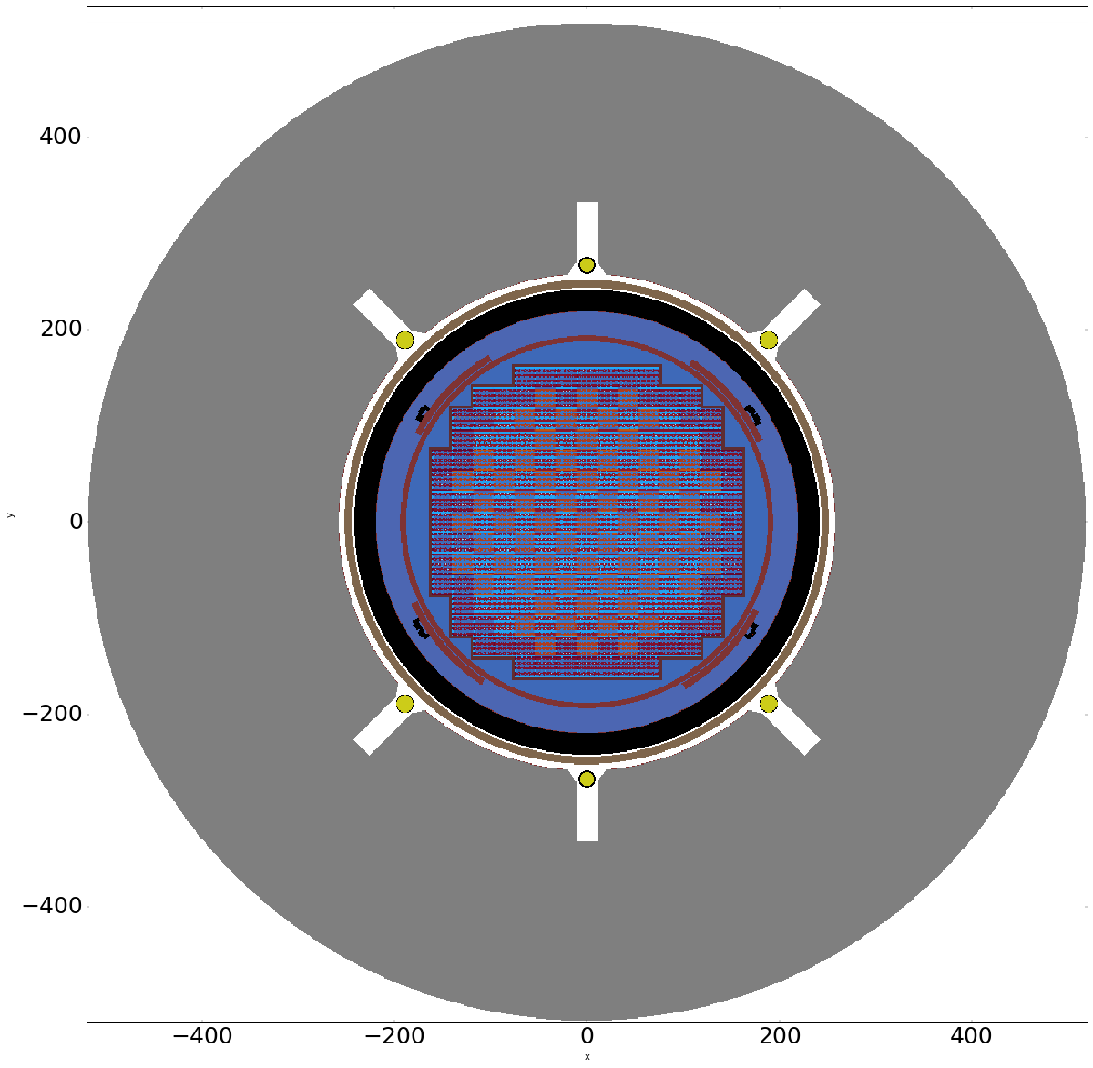
Full Core Watts Bar Model

Slide 7
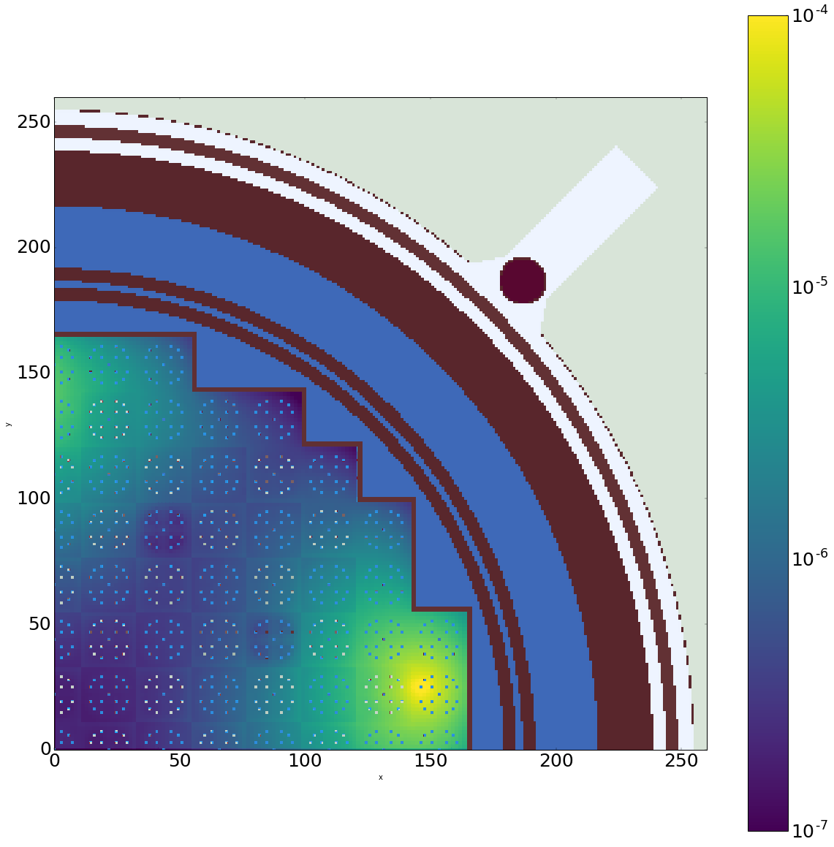
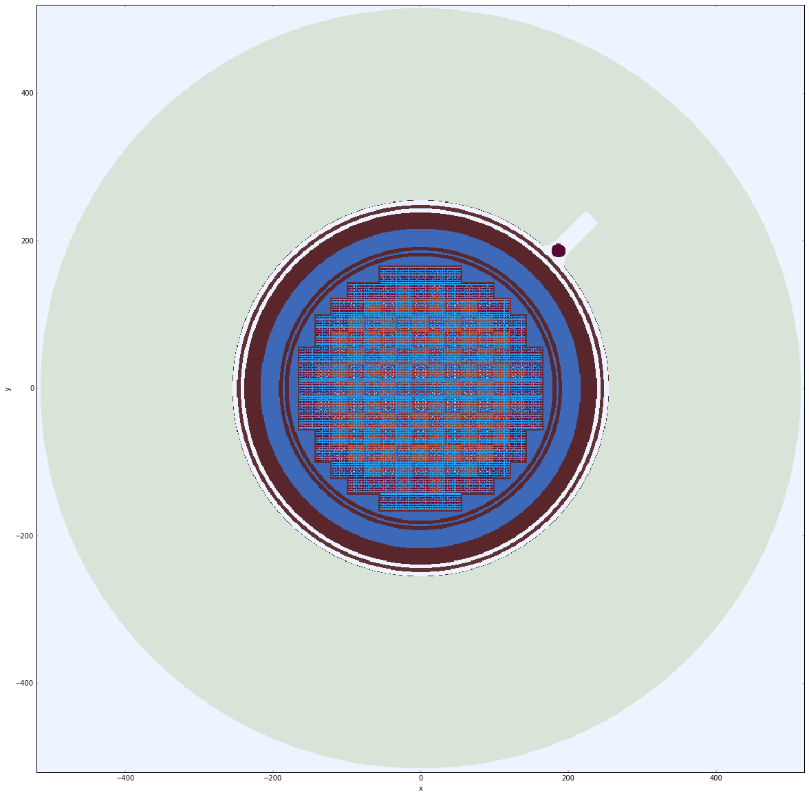
TMI – Ex-Core Model

Slide 8
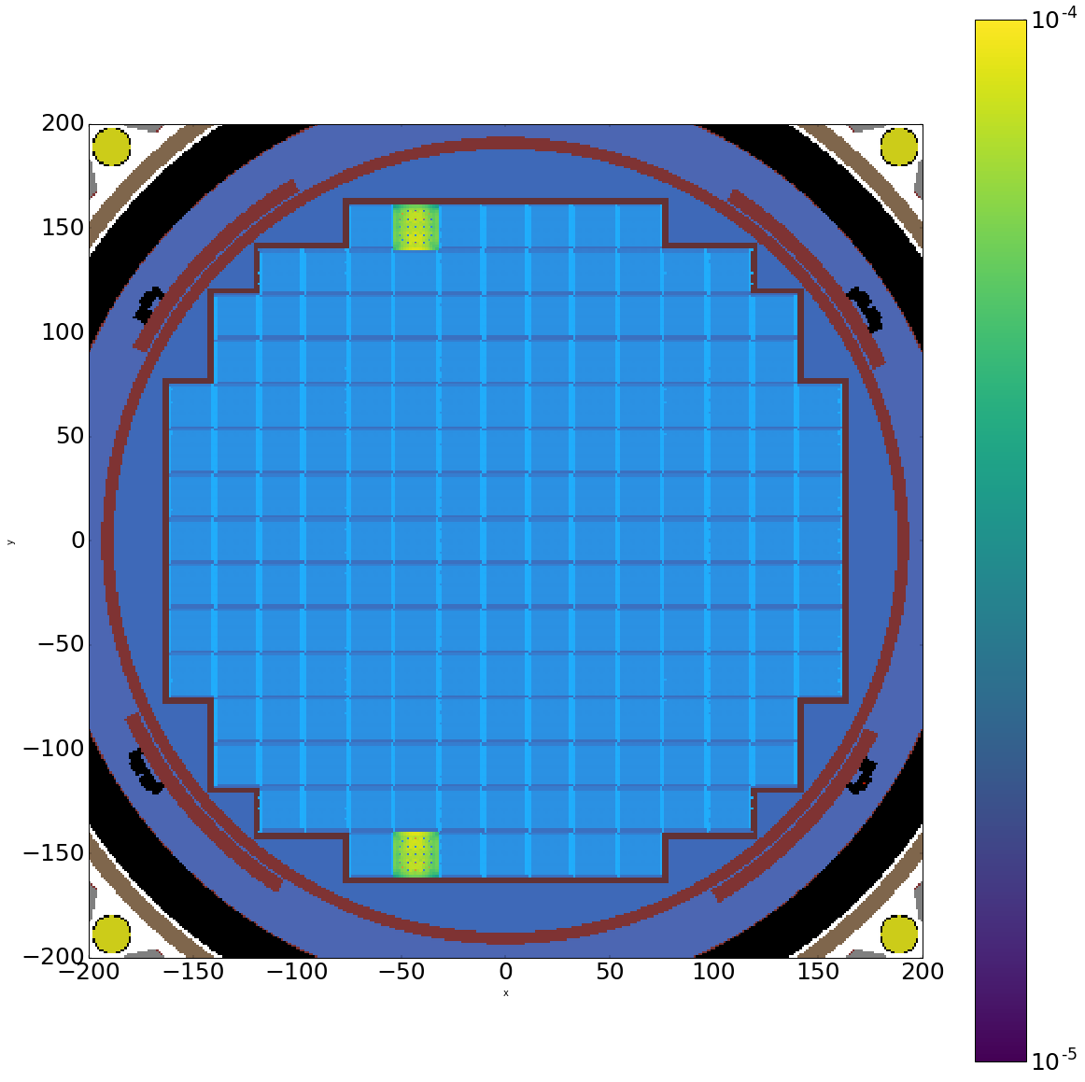
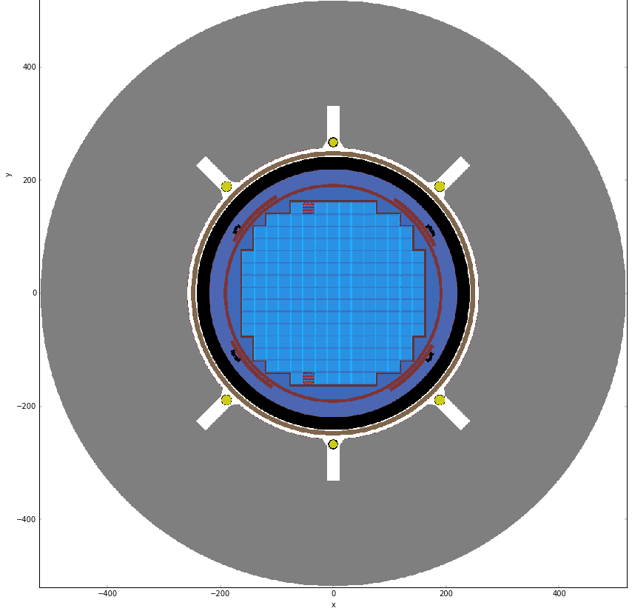
Secondary Source Calculations

Slide 9
User pitfall
Shift does not support rotational symmetry through VERA. It currently only supports mirror symmetry.
Any VERA input with rotational symmetrical must be unfolded manually in the input before running VERAShift
MPACT and Shift model different quadrants when we run quarter symmetry problems
This can be a major source of user input error if the excore region is not symmetrical
NE
SE
MPACT
Shift

Slide 10
QUARTER CORE EXAMPLE
SE

Slide 11
QUARTER CORE EXAMPLE
NE

Slide 12
Let’s Review an Omnibus Input:
cd /projects/vera-users-grp/training/session8/Excore/SimpleExample
vi smr-7x7.inp ! VERA Input
Vi smr-7x7.omn ! Omnibus Input

Slide 13
Let’s look through the *.shift.h5 output
You can load HDF5 files in a HDF5 viewer of your choice
Or you can use the following commands in your terminal window to look at the output
Type h5ls command and then the *.shift.h5 output file
You’ll see a list of groups
Add a forward slash to see contents of each group
Let’s explore the flux_tally group:
Use h5dump –d to view the values in binned flux:
h5ls smr-7x7.shift.h5
h5ls smr-7x7.shift.h5/STATE_0001
h5ls smr-7x7.shift.h5/STATE_0001/flux_tally
h5dump –d /STATE_0001/flux_tally/binned smr-7x7.shift.h5/

Slide 14
SHAPE types
See Exnihilo Manual for more information on different [UNIVERSE][SHAPE] functions
Note that other features listed in the manual is for standalone Shift is not applicable to VERA
[SHAPE=type] Cuboid / box Sphere Cyl Cylsegment / pad Ring / Cylshell Prism Slab Plane Wedge Cone Ellipsoid Hopper Righthet Triprism Ecylinder Rhombdod Ppiped quadric | Description Box Sphere Cylinder Cylinder segment Cylindrical shell Regular prism Infinite slab Infinite half-space Wedge Cone Ellipsoid Hopper Right tetrahedron Triangular prism Elliptical cylinder Rhombic dodecahedron Parallelepiped General quadric

Slide 15
Exercise
Copy smr-7x7.inp and smr-7x7-simp.omn
from /projects/vera-users-grp/training/session8/Excore/SimpleExample to your home directory
or files with solution provided at /projects/vera-users-grp/training/session8/Excore/ExcoreExercise

Slide 16
Exercise
Add a cylinder of radius 1.0 cm at (81.32, 81.32, 0) with z extents 100.0 and 140.0 using [UNIVERSE][SHAPE=cyl]
Define cells using [UNIVERSE][CELL cellname]
Set the material of the cylinder to void (provided in the COMP card)
Set up a tally to calculate the B10 response
[RESPONSE]definition provided in the input
Change the name of the hybrid_tally_names parameter to correspond with the TALLY name
Simple detector
Let’s run the problem!
verarun smr_example

Slide 17
HDF5 output
Type h5ls command and then the *.shift.h5 output file
Let’s explore the resp_tally_B10 group:
Use h5dump –d to view the values in the response tally:
h5ls smr-7x7.shift.h5/STATE_0001
h5ls smr-7x7.shift.h5/STATE_0001/resp_tally_B10
h5dump –d /STATE_0001/resp_tally_B10/total smr-7x7.shift.h5/
Only for response tallies:
First set of values correspond to flux
Second set of values correspond to response tally

Slide 18
What if I want to trouble shoot a geometry error?
This is more complicated and requires the use of iPython notebooks
Let’s review a sample notebook
If you would like to set up excore geometry using Omnibus for your problems, we will be happy to schedule a one-on-one training session with you to go over these advanced features

Slide 19
Let’s review a more complicated excore input

Slide 20
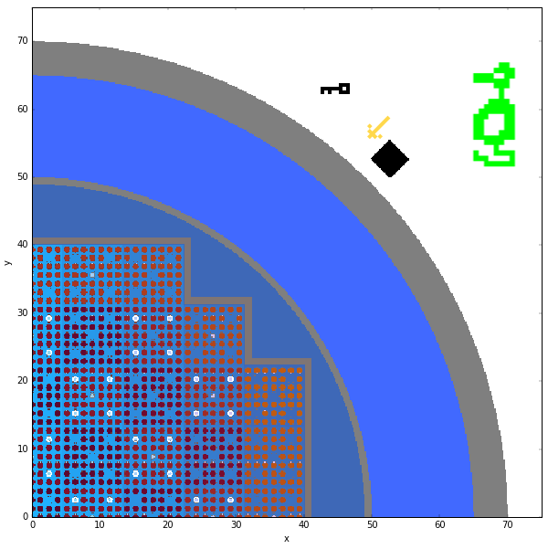
Questions?

