Slide 1
VERA Training: Vessel Fluence
VERA Training
February 14, 2019
Oak Ridge National Laboratory

Slide 2
Training Objectives
Give an overview of input pertinent to vessel calculations
Review simple vessel fluence input
View output in VERAView

Slide 3
VERA with CADIS
These fixed source Shift calculations can be performed in forward mode with no variance reduction (VR) or with Consistent Adjoint-Driven Importance Sampling (CADIS)
Space- and energy-dependent weight windows for Shift generated using Denovo, a discrete ordinates solver in ORNL’s Exnihilo code suite
Adjoint

Slide 4
Vessel Fluence and Excore Calculations with VERA
Advanced simulation methods to calculate time-dependent and fully coupled solutions for coupon fluence, pressure vessel fluence and ex-core detector responses for multiple cycles, each of which can contain a user-specified number of state points
In-core transport with temperature feedback is performed by coupled MPACT and COBRA-TF calculations
Fluence and detector response calculations outside the core barrel are performed by Shift
Ex-core region is defined using Shift’s general geometry package also known as Omnibus general geometry (GG) while the in-core geometry is defined using the standard VERA input

Slide 5
Excore Calculations with VERA
MPACT
Shift
Spatial fission source
Detector response tallies or coupon flux/reaction tallies
COBRA-TF
Denovo
MPACT and Shift run on separate cores
num_space parameter in the [MPACT] block refers to the number of cores MPACT requires for the problem
num_blocks_i and num_blocks_j parameters in the [SHIFT] block provide information on the number of SHIFT cores required
Note these parameters are associated with CADIS and is the default method when invoking SHIFT for excore calculations. Default is 10 x 10 = 100 cores for SHIFT.
If the user specifies that they want to run a problem in forward mode, then these parameters are not specified and the total number of cores for SHIFT must be specified when invoking verarun

Slide 6
SHIFT Default Parameters
Most hybrid parameters that speed up calculations are in SHIFT.ini file
The SHIFT.ini file is in the build directory
Once you are there, change directory to $HOME/bin/Init
We have hidden a lot of the advanced parameters there
Expert users of hybrid methods may want to toggle these parameters
However, these have been set to the optimum for most problems except for a few parameters that all users must specify for their specific problems

Slide 7
Simple SMR Input
Open vessel fluence sample input file
Add parameter to turn on excore transport in the first [STATE] block
Requires [SHIFT] block in VERA input
Submit job: verarun small_core_cadis_sn_deplete.inp
[STATE]
excore_transport on
[SHIFT]
Np 50e6 ! # of particles (Default: 1,000,000 particles)
output_adjoint true ! Produces HDF5 file with the adjoint (Default: false)
num_blocks_i 10 ! Denovo decomposition in x direction (Default: 10)
num_blocks_j 10 ! Denovo decomposition in y direction (Default: 10)
!
! tally_information
n_bounds 2.0e7 1.0e6
num_theta 128
num_axial 10
radial_mesh 0 61.99999 63.0 64.0 65.0 66.0 67.0 68.0 69.0 70.0 71.0 72.00001

Slide 8
Review of SHIFT.ini Default Parameters
SHIFT.ini Default | Description
problem_mode cadis | Run mode (forward/cadis)
mode n | Type of particles to transport (n=neutrons, np=neutrons and photons)
verbosity low | How often to print out particles being transported (none/low/medium/high)
do_transport true | Perform Monte Carlo transport
transfer fiss_src | What to transfer from MPACT (only option for excore calculations)
output_geometry true | Output HDF5 files of raytraced geometry (initial) and compositions (each state)
output_fission_source true | Output the initial fission source for each state
output_external_source false | Placeholder for future capability to add external source
transport ce | Continuous energy (only option for excore calculations)

Slide 9
Review of SHIFT.ini Default Parameters
SHIFT.ini Default | Description
thermal_energy_cutoff 10.0 | Cutoff for treatment of thermal neutrons (eV)
Np 1000000 | Number of particles to transport
src_disc_l2_error 1e-3 | Maximum L2 error for point-sampling discretization
src_disc_samples_per_batch 10000000 | Number of samples per point-sampling batch
src_disc_max_samples 1000000000 | Maximum number of discretization samples
use_mpact_spectrum false | Flag on whether to use the MPACT fission source spectrum. If false, a U-235 Watt spectrum is used.
use_fission_source true | Flag that indicates a fission source is being used
Notes:
Thermal – S(a,b), and if there’s no S(a,b), then dbrc, and if not, then elastic scattering

Slide 10
Review of SHIFT.ini Default Parameters
SHIFT.ini Default | Description
use_external_source false | Placeholder for future capability for flag that indicates that an external source is being used
create_unique_pins false | Make all pincells unique compositions
global_log info | Level of global log information (debug/ diagnostic/status/info/warning/error/critical)
eq_set sc | Solution method or spatial discretization for hybrid calculation (sc=step characteristics for excore calculations)
Pn_order 0 | Order of moments
mesh 1 | Number of mesh cells per pincell
dimension 3 | Spatial dimension of the problem
adjoint true | Perform adjoint solve
output_adjoint false | Output adjoint flux to SHIFT HDF5 file and adjoint source to separate HDF5 file

Slide 11
Review of SHIFT.ini Default Parameters
SHIFT.ini Default | Description
num_blocks_i 10 | Number of partitions (processors) in x
num_blocks_j 10 | Number of partitions (processors) in y
xs_library v7-56 | Name of SCALE MG data library file
num_groups 8 | Number of energy groups
new_grp_bounds 6.0653E+06 3.6788E+06 2.3457E+06 1.6530E+06 8.2085E+05 2.4176E+04 1.0130E+02 1.0000E-05 | Collapsed group boundaries for weight windows. Note these are lower bounds and these default values are from BUGLE-96 neutron group bounds.
max_delta_z 5.0 | Maximum core mesh size in z
upscatter_verbosity high | Log verbosity for upscatter solver
upscatter_subspace_size 20 | Upscatter solver subspace size
refl_mesh_size 5.0 | Radial axial mesh size in excore region
extend_axial_mesh_size 5.0 | Adjoint axial mesh size in excore region
store_fulcrum_string false | Save fulcrum string as file

Slide 12
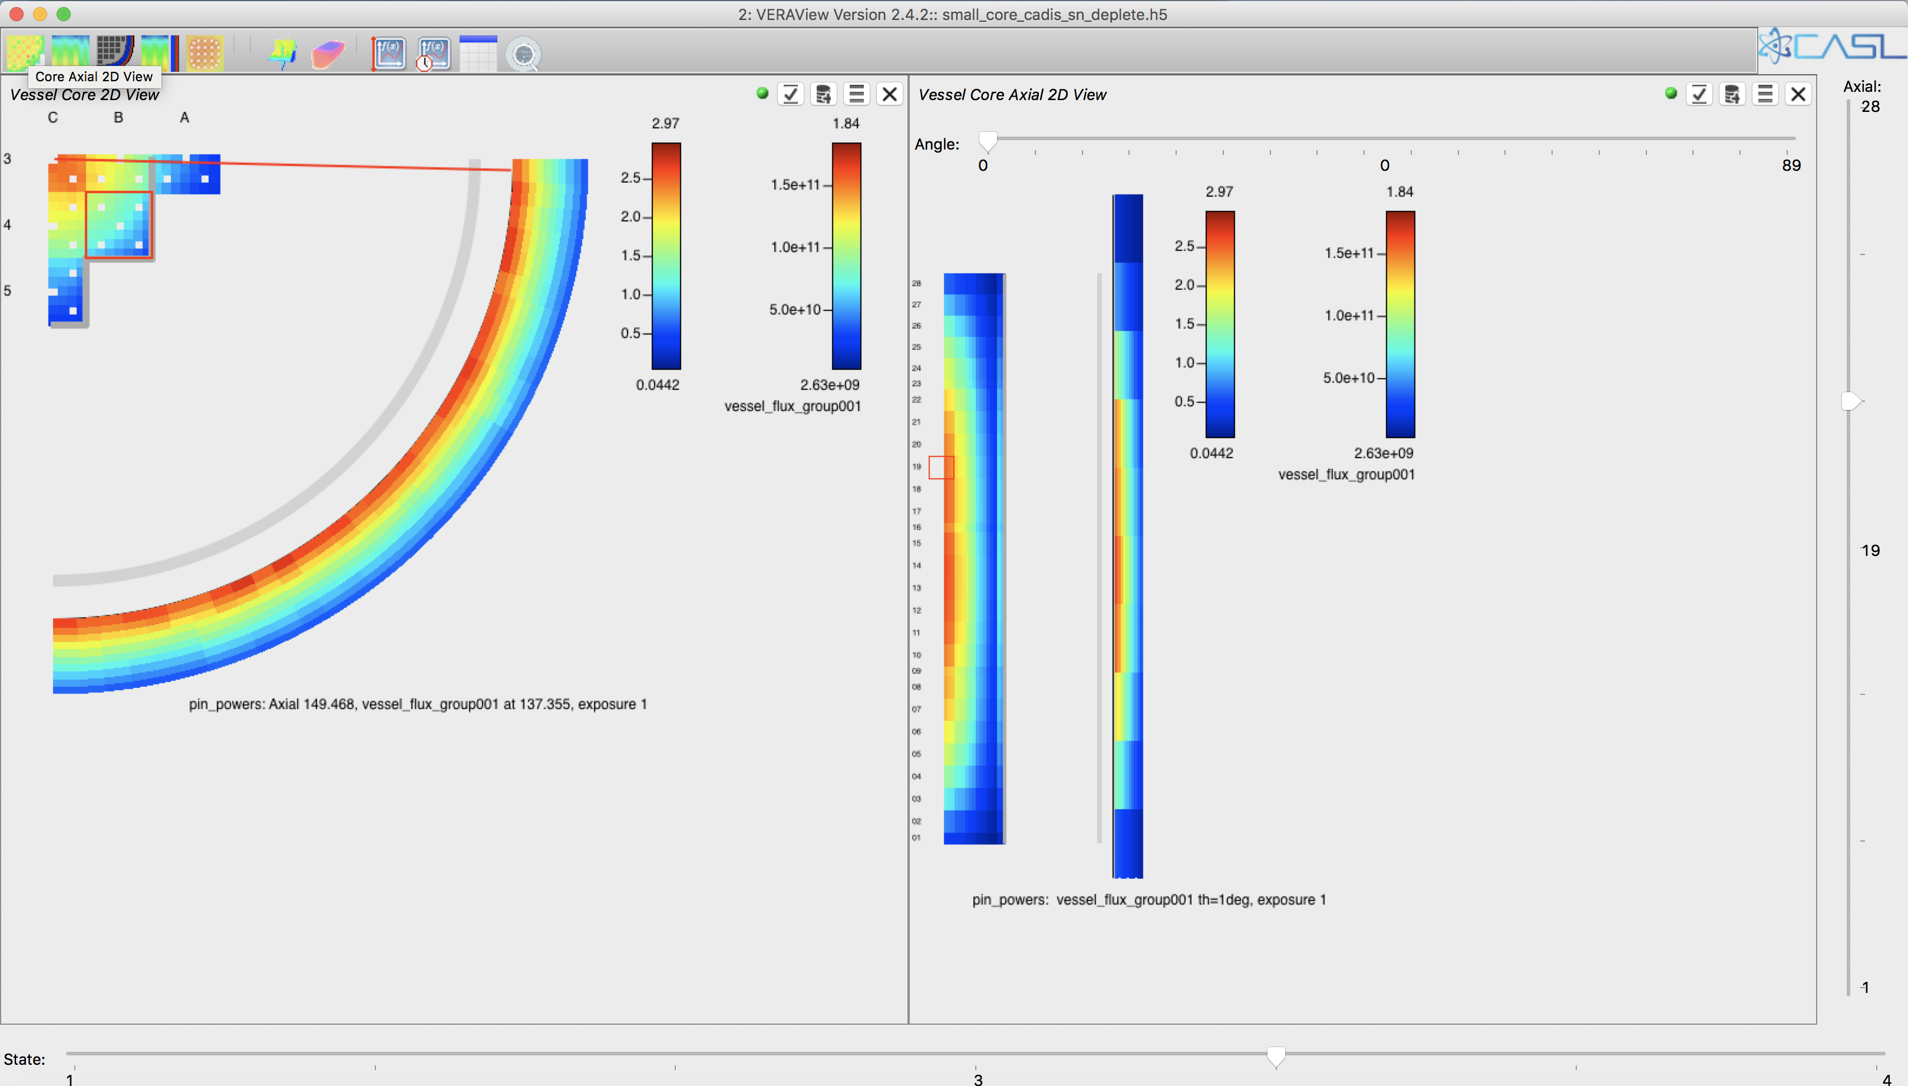
VERAView
Open VERAView
Load Single New File (small_core_cadis_sn_deplete.h5)

Slide 13
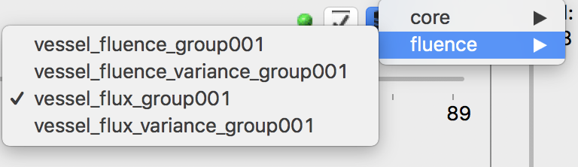
VERAView
Vessel core 2D radial view
Vessel core axial 2D view
Slide to change angle
Click to open vessel data
Slide to change axial planes and
view changes in 2D radial view
Slide to toggle through different statepoints to view fluence and flux

