Slide 1
Session 6 – CILC Inputs and Training Exercise
VERA Users Group Training
Oak Ridge National Laboratory 2/14/2019

Slide 2
Contents – Session 6
VERA CILC Analysis Overview
Source term initialization
Additional input for CILC analysis
Multistate CTF
Whole-core CILC screening exercise
Single assembly high-resolution CILC exercise
VERAView CILC Capabilities

Slide 3
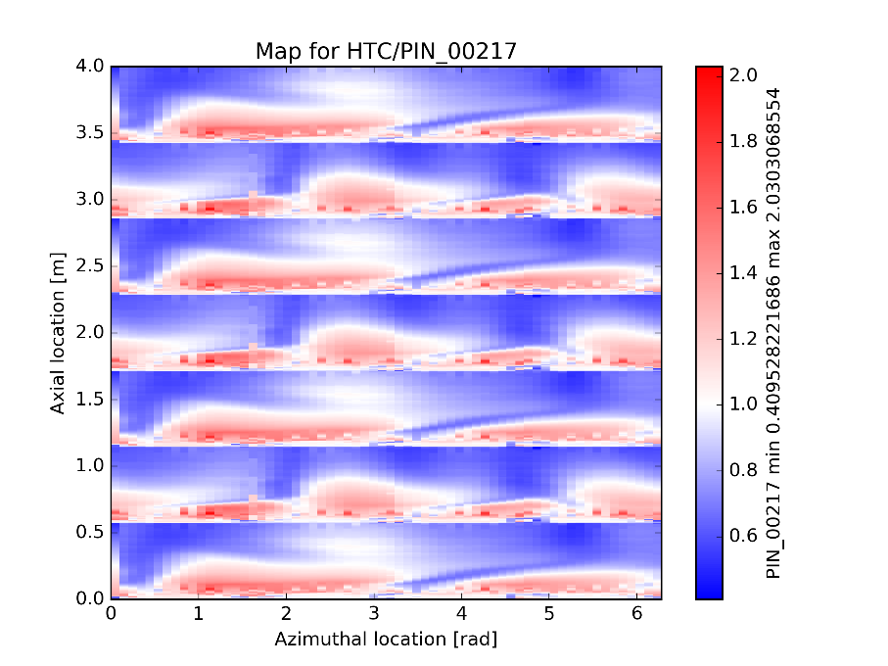
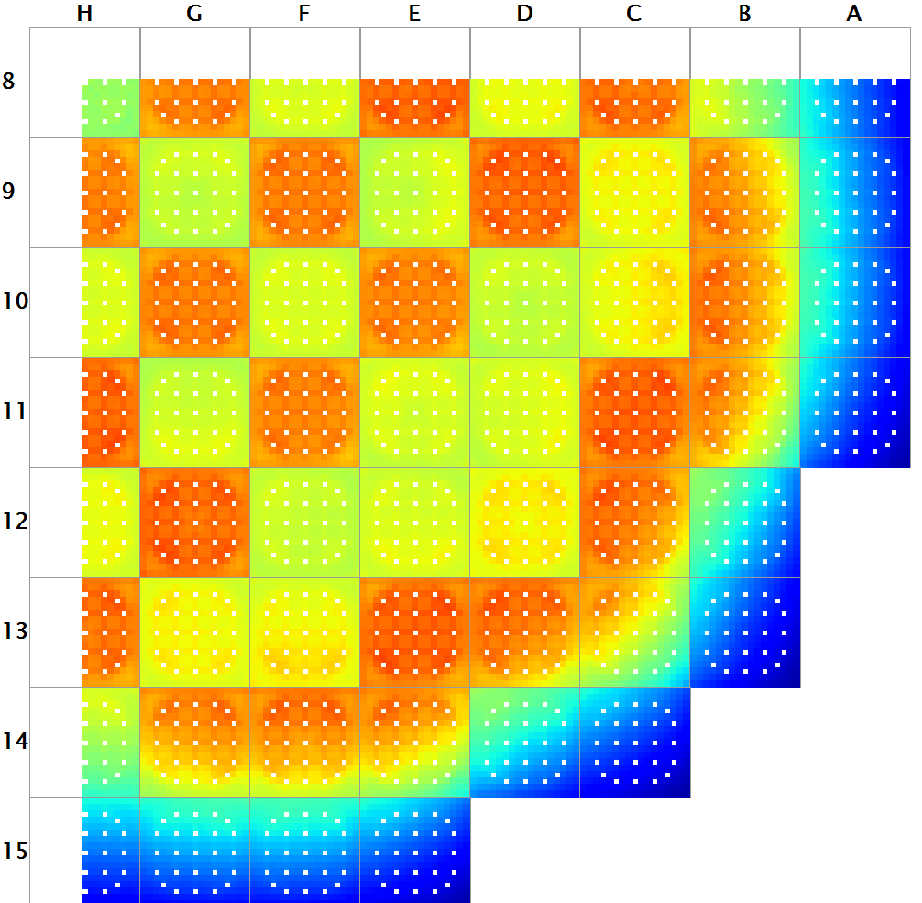
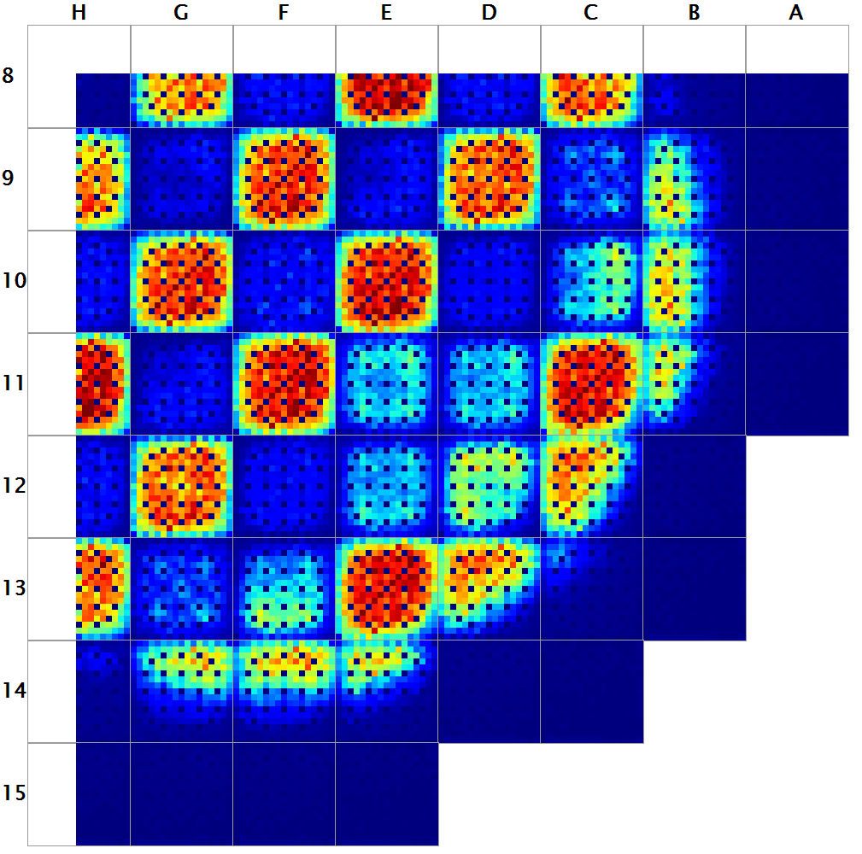
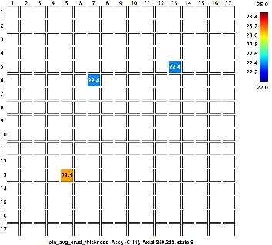
CILC Analysis Overview
MPACT/CTF/MAMBA
Full model simulation
Obtain power shape for next steps
Recognize CIPS, if present
Low Resolution CTF/MAMBA
Identify limiting assemblies and rods with those assemblies
Lower resolution
CFD HTC and TKE Maps
High Resolution CTF/MAMBA
Interrogate individual assemblies/rods
ROTHCON resolutions of 4x4 up to 16x16 (depending on your CFD maps)

Slide 4
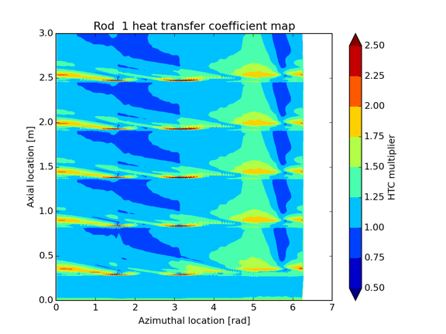
Hi2Lo Model Approach
Use a shape function to capture heat transfer shape as a function of grid geometry
Similar to approach of Yao-Hochreiter-Leech
Rather than general correlation, STAR-CCM+ is used to create a model of specific grid at nominal PWR operating conditions and HTC shape is extracted

Slide 5
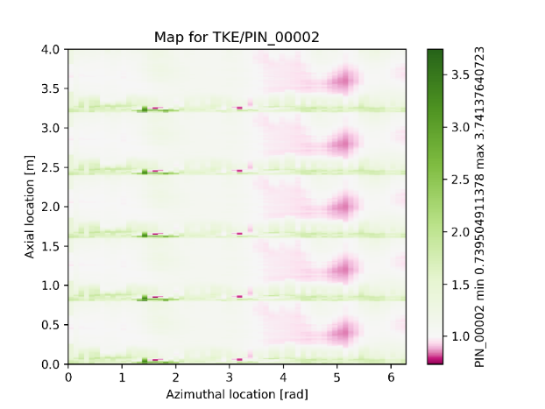
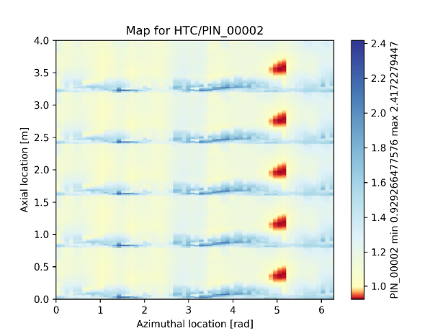
ROTHCON Overview
Rod thermal hydraulic reconstruction (ROTHCON)
CFD maps of local surface HTC and TKE
CFD data averaged to reconstruction mesh
Supplied map, data available at vertices
Coupling mesh surface bounds
Use linear interpolation to determine data on coupling mesh face bounds
Perform weighted averaging of supplied map data onto coupling mesh

Slide 6
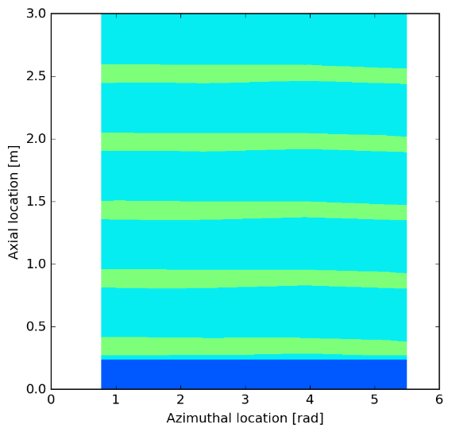
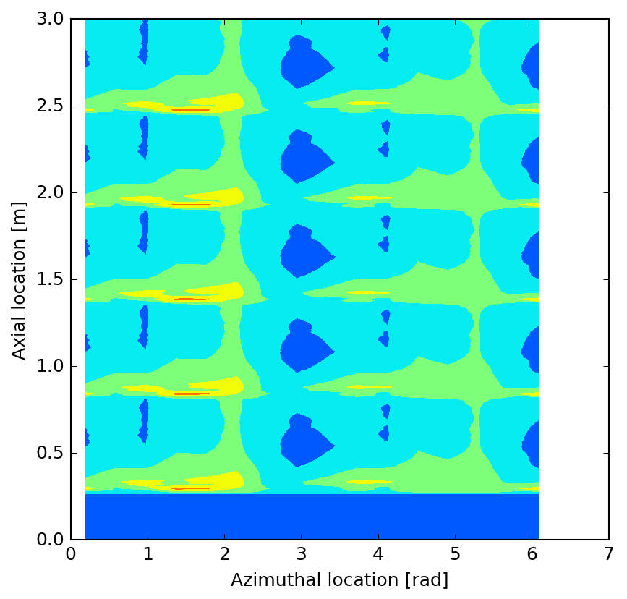
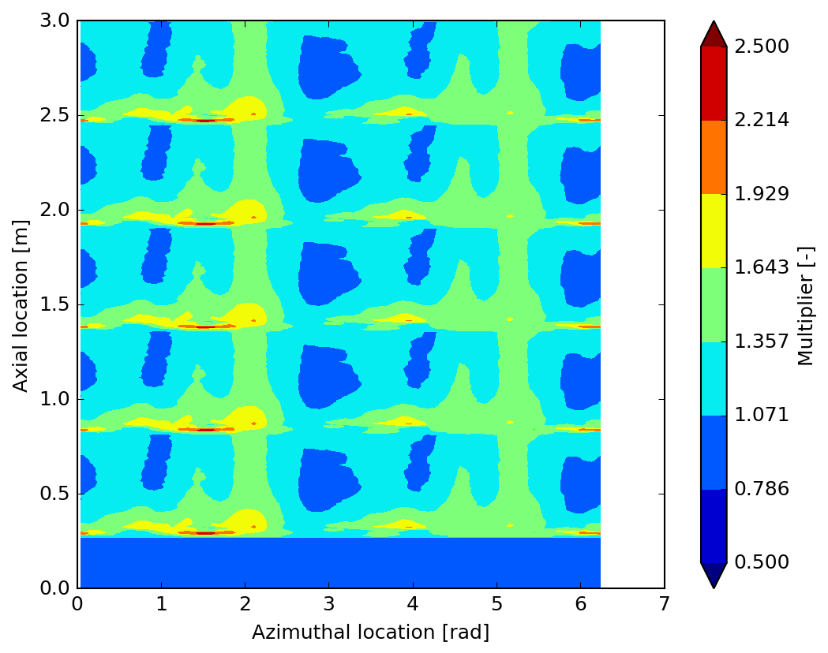
ROTHCON Refinement Study
Default CTF mesh has 4 azimuths per axial level
Coupling mesh allows the user to refine that mesh by a multiple
Plots showing HTC multiplier maps at different refinement levels
1x1
4x4
8x8

Slide 7
Effects of Using ROTHCON Maps
Resolve crud/corrosion “striping” at higher ROTHCON resolutions
Use VERAView for visual screening for high risk rods

Slide 8
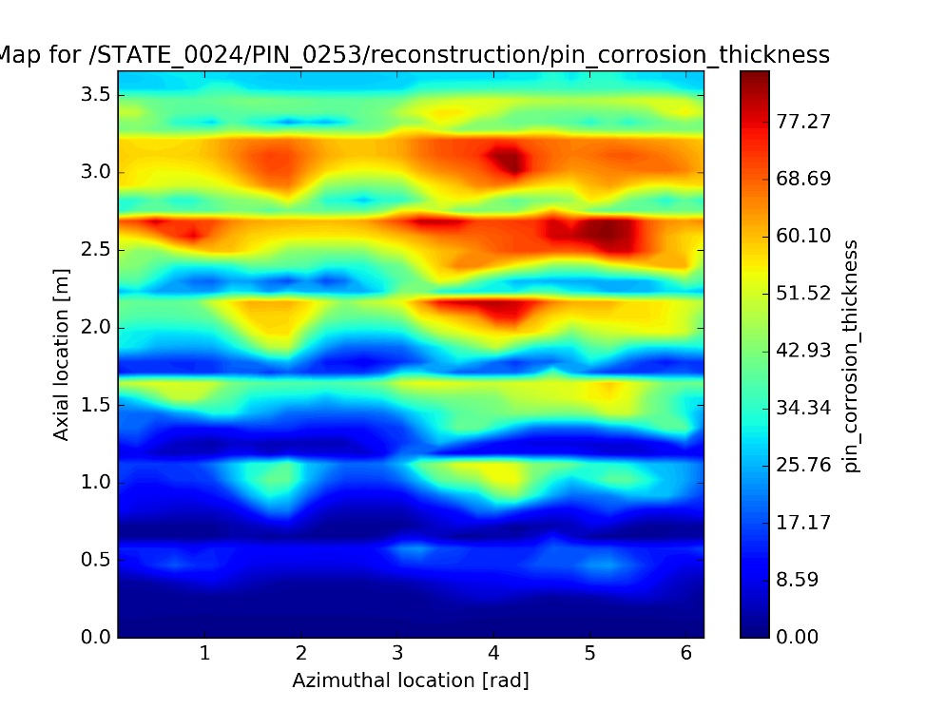
Importance of Azimuthal Resolution in CILC Analysis
Strong azimuthal variance for corrosion thickness in both measured data and VERA with CILC analysis
Measured Data
Example
VERA

Slide 9
Multistate CTF: T/H + CRUD
Multistate CTF
[STATE]
crud on
[RUN]
exe_mode th
nprocs 1
Requires pre-calculated pin powers in deck.h5

Slide 10
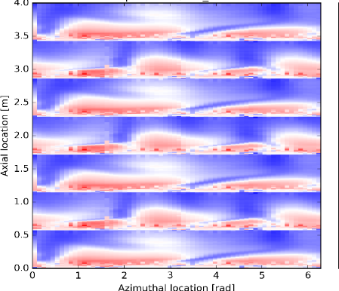
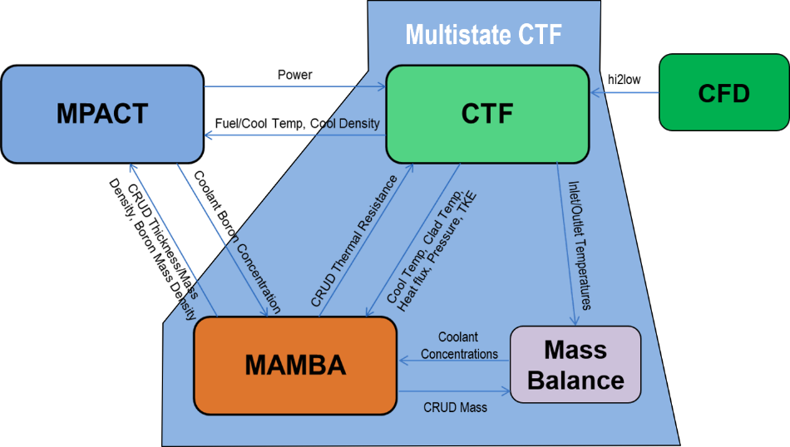
Current CILC Analysis Process with VERA
Full/Qtr Core
Single Assembly
**What do you think?
deck.ctf.h5
deck.ctf.native.h5
deck.h5
Convert to VERView compatible file
Extract single
assembly
Output.VERAView.h5
Output.h5
Multistate CTF with ROTCON maps

Slide 11
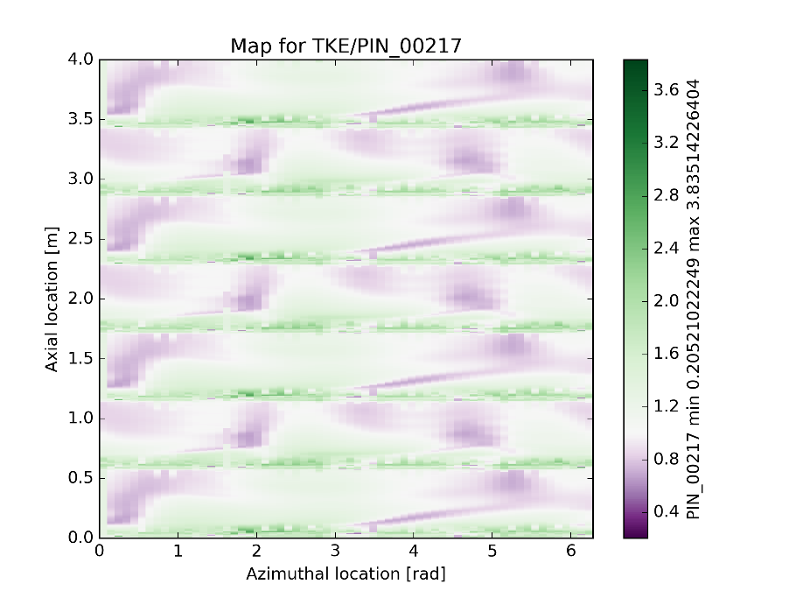
ROTHCON Grid Maps Files – gridDataFile.h5
HDF5 file that contains the mesh and the HTC and TKE maps for each pin in the assembly
289 maps for 17x17 assembly
Each map has minimum of 32 azimuths and 180 axials
Maps can be stacked for different grid types
HTC Map
TKE Map

Slide 12
Source Term Initialization Input Overview
<type:utube|oncethrough> <alloy:600|690|800|304>
<area (m^2)>
<plugged fraction (0.0 to 1.0)>
[CORE]
steam_generator utube 690 9200 0.05
hot_leg_piping 304 1000
cold_leg_piping 304 1000
cleanup_rated_flow 50
rcs_volume 140
[STATE] deplete GWDMT 1.0; cleanup_flow 80
[STATE] deplete GWDMT 1.5
[STATE] deplete GWDMT 1.5; cleanup_flow 100
[MAMBA]
steam_generator_age 4
piping_age 10
chem_mass_bal 2
.
<alloy:600|690|800|304> <area (m^2)>
Total rated cleanup flowrate (kg/s)
Total reactor coolant system volume (m^3)
% of rated cleanup flow
0 no mass balance
1 constant source term rate
2 parabolic source term model

Slide 13
VeraView CRUD Analysis Capabilities
Open cips_smr.h5 in VERAView
Data Analysis View shows the value of your selected dataset and sorts by maximum
Shows assembly and pin (column, row)
Data Thresholds allow you view values with applied thresholds (>, <, >=, <=, !=) for either absolute values or percentages

Slide 14
CILC Exercise with Single Assembly from SMR Cycle
CAVEAT!
These models are optimized for speed and to show explicit CRUD effects. Many of the values for the inputs in these models are non-normal!
Make sure you are in your home directory
cd
Copy session6 files to your home directory
cp –r /projects/vera-users-grp/training/session6 .
Move into the session6/cilc_single_assembly directory
cd session6/cilc_single_assembly

Slide 15
Extracting assembly for high-resolution CILC analysis with CTF Multistate
Select your assembly of interest to analyze in more detail
For advanced users: it is possible to select single pins or to only have high resolution on select pins in the assembly
End up with file named nocrud_smr.MS.h5
**What do you think?
python ~/session6/scripts/write_MSpowers.py
~/session5/nocrud_smr/nocrud_smr.h5 6
Output.h5 from previous coupled simulation
Chosen assembly number

Slide 16
CILC Exercise with Single Assembly from SMR Cycle
Link nocrud_smr.MS.h5 to deck.h5
ln –s nocrud_smr.MS.h5 deck.h5
Copy the gridDataFile.h5 into cilc_single_assembly directory
cp ../gridDataFile.h5 .
Need cilc_single_assembly.inp, deck.h5, gridDataFile.h5

Slide 17
CILC Exercise with Single Assembly from SMR Cycle
Open cips_smr.inp and add/change the following inputs:
Execute VERA with MultiState CTF
verarun cilc_single_assembly.inp
[Assembly]
grid MID zirc4 3.810 875 / loss= 0.9 gridmap=GRID1
[COBRATF]
hi2lo_sub_theta 4
hi2lo_sub_axial 1
model_corrosion 1
clad_corrosion_model 3
crud_details 1
edit_native_hdf5 1
[RUN]
exe_mode th
nprocs 1
Name has to match with name on gridDataFile.h5
Resolution increase on T/H mesh for ROTHCON
Turns on corrosion modeling
Clad corrosion model can be:
1 – Zirc-4 (default)
2 – M5
3 - ZIRLO
Enables high resolution CRUD output edits
Runs Multistate CTF
**Runs in serial for high resolution crud data

Slide 18
VeraView CRUD Analysis
Subpin Length Plot is a CRUD/corrosion widget that is a geometric representation of fuel rod
Depicts both crud and corrosion thickness on ROTHCON mesh
Can hover over each azimuth of CRUD/corrosion to see value
Pellet-Clad Gap
(not to scale)
Fuel Pellet
(not to scale)
Crud Thickness
Cladding Thickness
Corrosion Thickness
Pin Surface Map Plot shows fuel rod clad as if it was cut axially and unrolled to show the outer surface
Currently shows only CRUD
*y-axis units should be [cm]
**What do you think?

Slide 19
Convert Multistate CTF Outputs Files to VERAView Compatible File
Need deck.ctf.h5 and deck.ctf.native.h5 from Multistate CTF
Use post processing converter
python ~/session6/scripts/ctfnative2veraview.py
Generates VERAView compatible file called deck.VERAView.h5
python ~/session6/scripts/ctfnative2veraview.py deck.ctf.h5 deck.native.ctf.h5
Outputs from Multistate CTF

Slide 20
VERAView Practice
Visualize CRUD with VERAView from:
~/session5/cips_smr/results/cips_smr.h5
~/session5/shuffle/results/shuffle.h5
~/session6/cilc_single_assembly/results/deck.VERAView.h5
~/session6/cilc_single_assembly/results/4x1.VERAView.h5
~/session6/cilc_single_assembly/results/8x1.VERAView.h5

Slide 21
Thank You!

Slide 22
Extra Slides

Slide 23
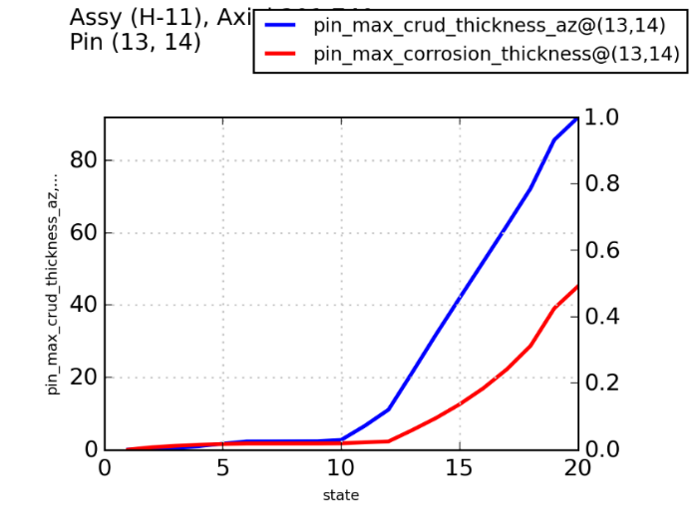
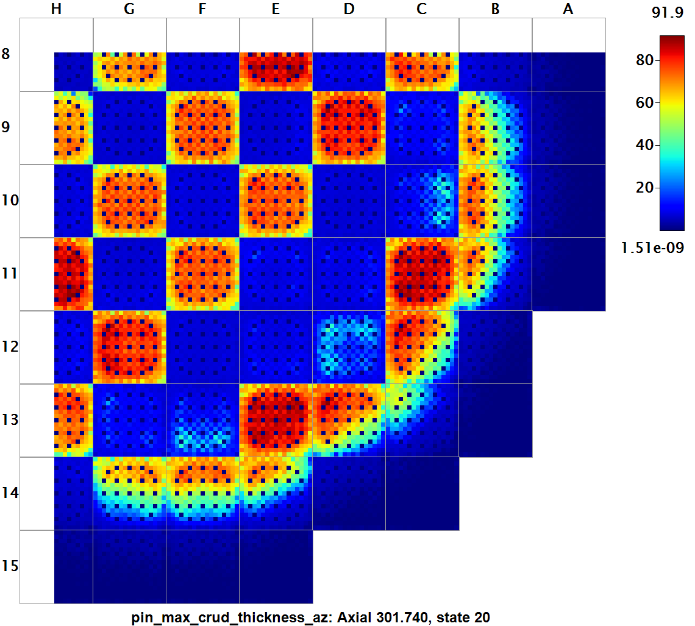
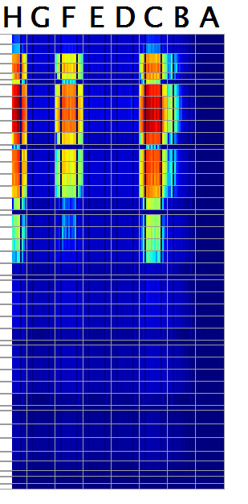
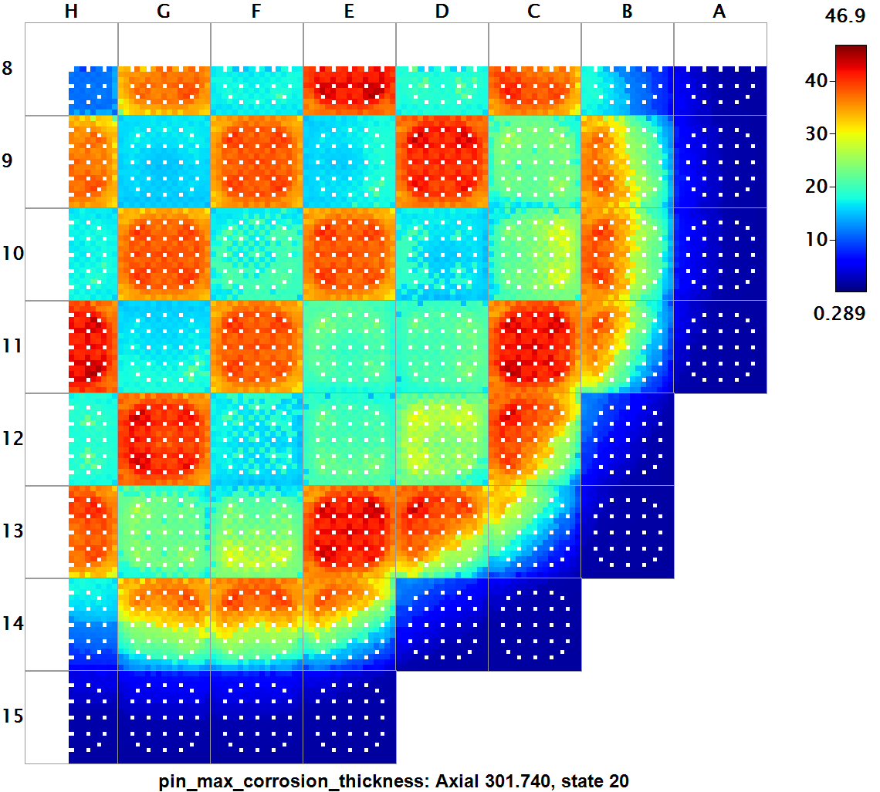
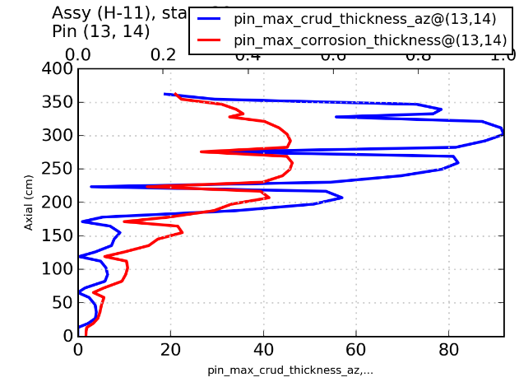
Seabrook Cycle 5 Quarter Core Results
Maximum Crud Thickness [u]
Oxide growth transitions once greater than ~2 u
Initial cladding oxide will effect final thickness
Maximum Corrosion Thickness [u]
Crud distributions much more reasonable
Oxide thickness on the order of crud thickness
Grid effect shown in Hi2Lo maps

