Slide 1
Session 5 – CIPS Inputs and Training Exercise
VERA Users Group Training
Oak Ridge National Laboratory 2/14/2019

Slide 2
Contents
VERA CIPS Analysis Overview
CRUD/Chemistry input overview
CIPS exercise with SMR cycle
Cycle with enough CRUD/boron to show CIPS
CRUD shuffling and cleaning
Cycle with crud with restart file
Cycle with crud shuffle
CRUD capabilities in VERAView
Postprocessing for AO deviation and pin power differences using VERAView
Look at whole-core crud and crud shuffle

Slide 3
Disclosures
Mamba is still under development
Milestones this year for
Mass balance
Calibration
Documentation
CILC tools are still under development
Milestone to improve usability
Officially outline and document updated CILC capability
This give you the chance to be involved and help form the tools

Slide 4
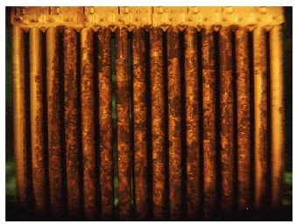
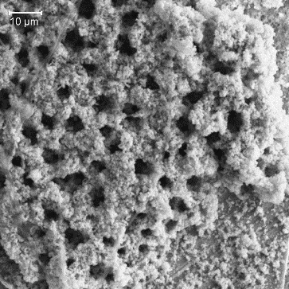
Crud Deposition in Reactors
Crud is the buildup of particulate and dissolved metals and metal oxides on the fuel rod surfaces and is problematic because:
It reduces heat transfer
It accelerates cladding oxidation/corrosion
It provides a structure for the hideout and precipitation of chemical species
Crud Induced Power Shift (CIPS) is the neutronic feedback to the precipitation of significant amounts of boron containing chemical species
Crud deposition negatively affects the operation and efficiency of reactors

Slide 5
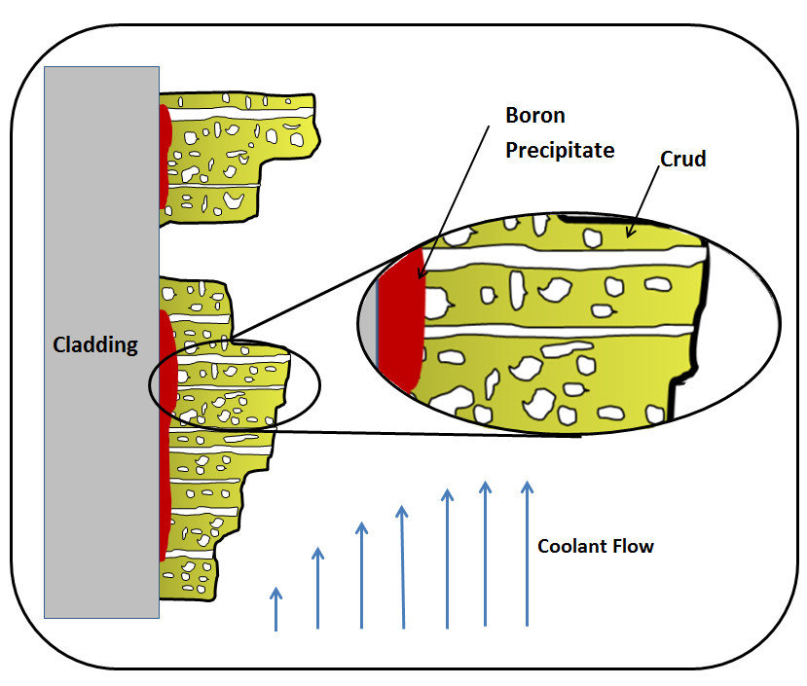
Root Cause of CIPS
LiBO₂, Li₂BO₇, and Li₂B₄O₇
EPRI. (1997). Rootcause Investigation of Axial Power Offset Anomaly.
CIPS is a complex thermal-chemical-neutronic interaction

Slide 6
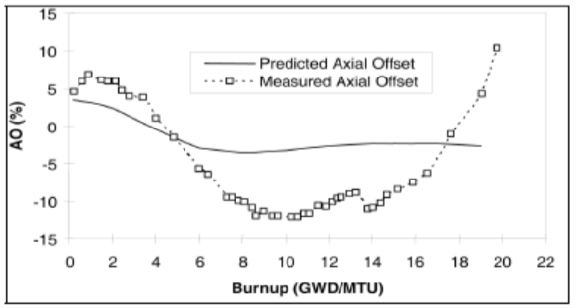
Effect of CIPS on Reactors
CIPS leads to an imbalance in the core power distribution and decreases operation margin
6

Slide 7
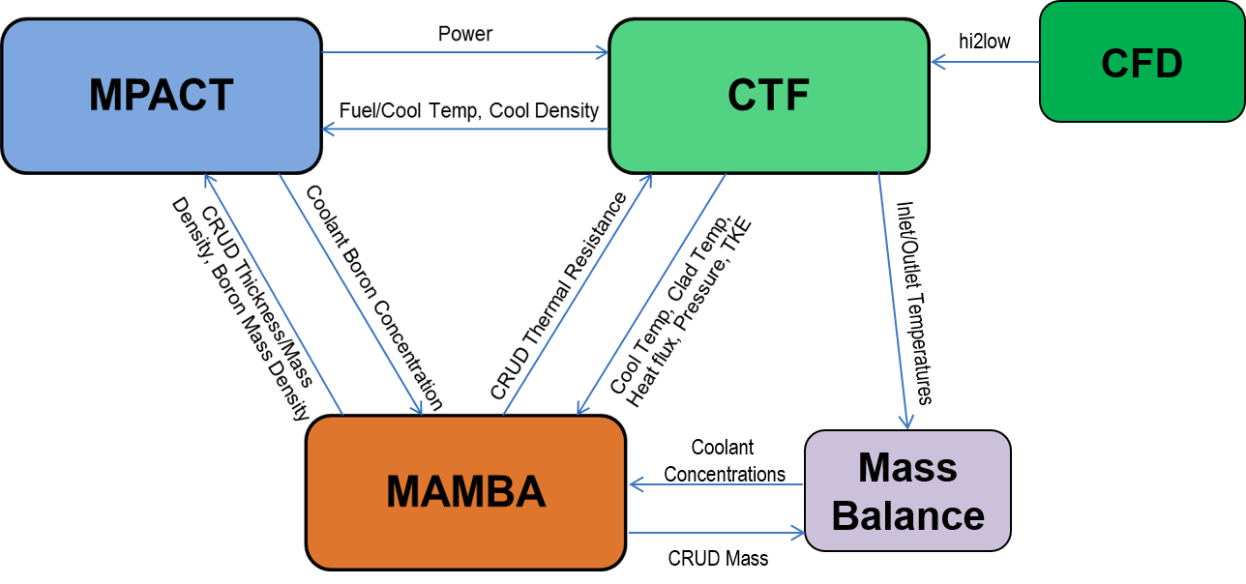
VERA CRUD Analysis Overview
Captures coupled neutronics, thermal-hydraulic, source term, and clad chemistry
Able to run all physics or subsets for more flexibility
Adds input from CFD to capture rod surface distributions
Single capability to handle CIPS and CILC

Slide 8
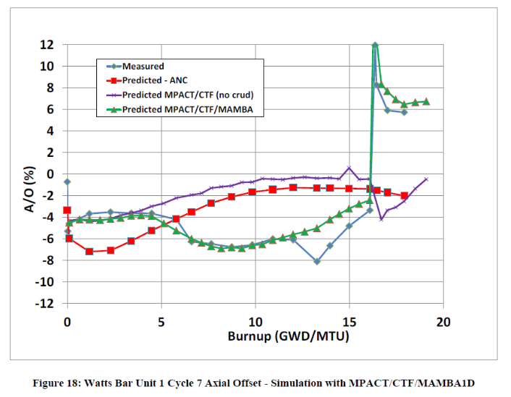
Why use CRUD physics in VERA? CIPS Analysis of Watts Bar 1 Cycle 7
Look at detector response for these points in time
VERA has been used to perform CIPS analysis of
Caveat!
MAMBA is not yet predictive and is still under active development.

Slide 9
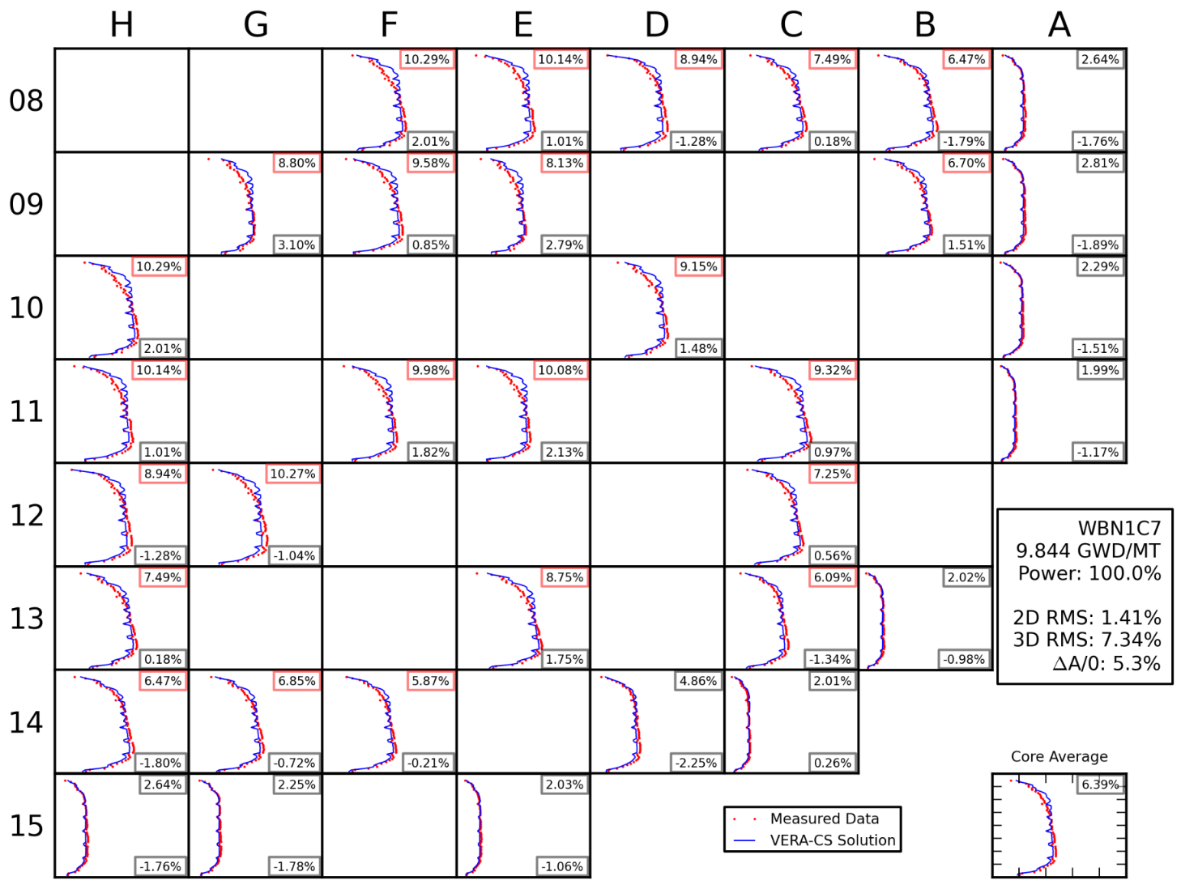
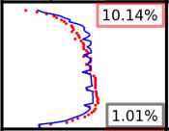
WB1C7 Detector Response – Before Shutdown
VERA without CRUD
VERA with CRUD

Slide 10
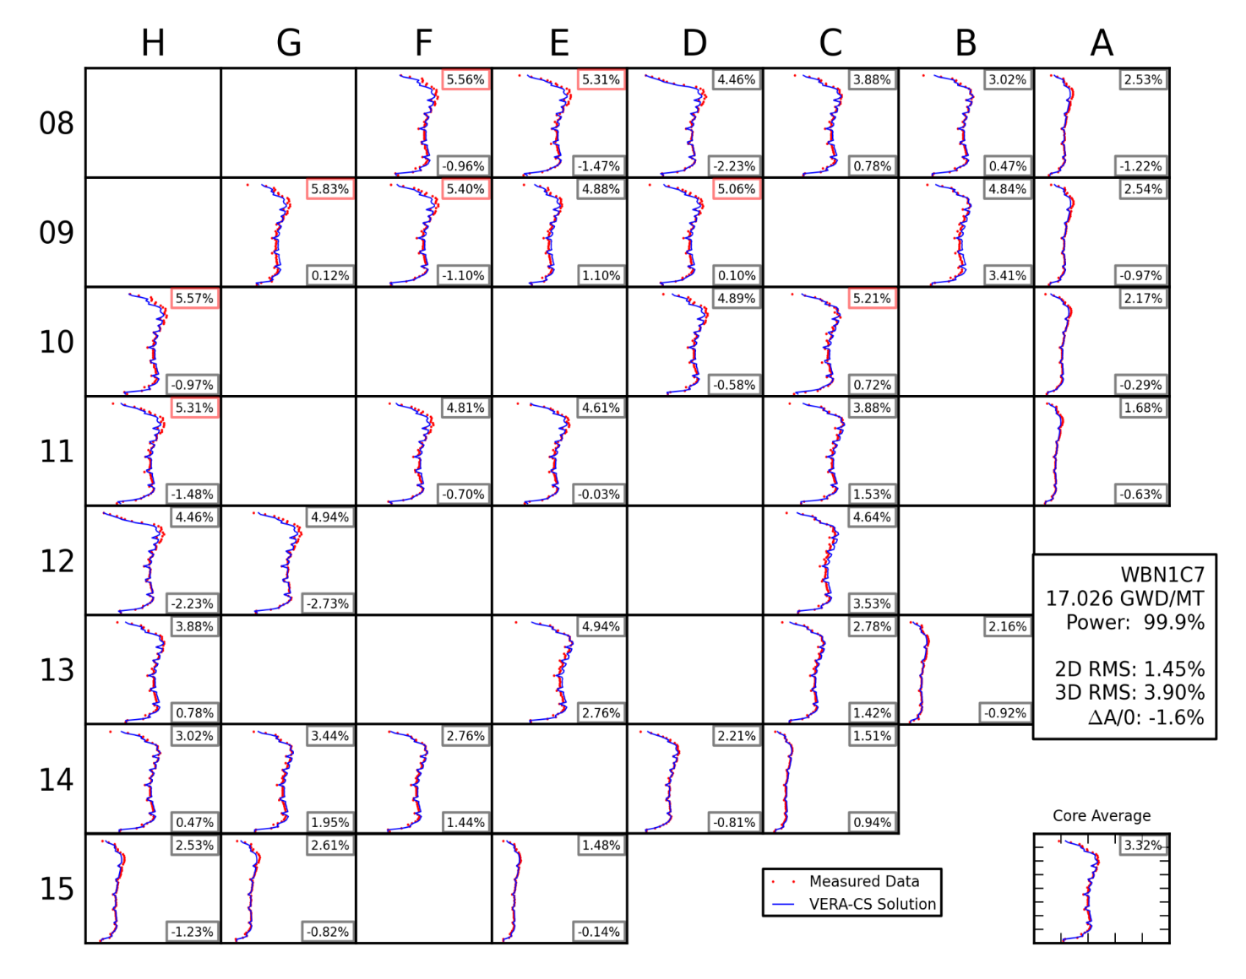
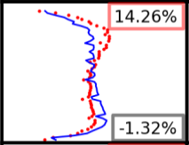
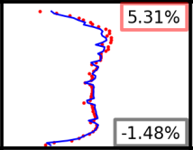
WB1C7 Detector Response – After Restart
VERA without CRUD
VERA with CRUD

Slide 11
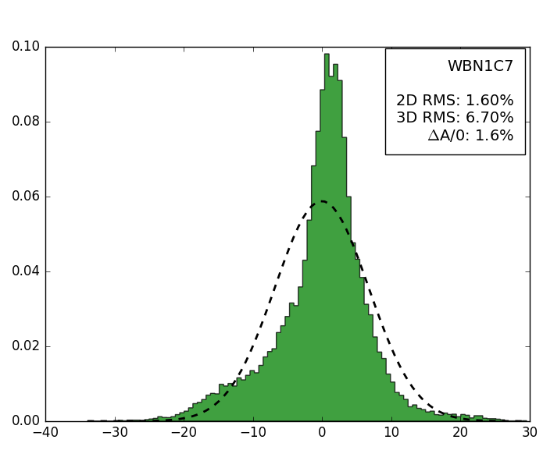
WB1C7 Cycle Average Error Distribution
VERA without CRUD
VERA with CRUD
The previous caveat still applies.
But if we can match the CIPS phenomena, then it is possible to predict CIPS phenomena if MAMBA can get the right amount of CRUD and borate in the right places.

Slide 12
Manual Crud/Chemistry Input Overview
[STATE]
crud on !Enables crud/chemistry physics package
[STATE] deplete EFPD 12; cool_chem 35E-6 2.2 0.19 2.120 1.8
[STATE] deplete EFPD 25; cool_chem 35E-6 2.2 0.19 2.194 1.7
[STATE] deplete EFPD 50; cool_chem 35E-6 2.2 0.19 2.193 1.7
[STATE] deplete EFPD 75; cool_chem 35E-6 2.2 0.19 2.890 1.7
[STATE] deplete EFPD 100; cool_chem 35E-6 2.2 0.19 2.688 1.7
[STATE] deplete EFPD 125; cool_chem 35E-6 2.2 0.19 2.890 1.7
[STATE] deplete EFPD 150; cool_chem 35E-6 2.2 0.19 2.688 1.7
Hydrogen Lithium Ni_sol Ni_par Fe_sol
(kg/m^3) (ppm) (ppb) (ppb) (ppb)
**What do you think?
[STATE] deplete EFPD 100; ni_p 2.890; ni_s 0.19
[STATE] deplete EFPD 125
ni_p 2.720
ni_s 0.19
Moving towards individually named cards in each [STATE]

Slide 13
CIPS Exercise with SMR Cycle
CAVEAT!
These models are optimized for speed and to show explicit CRUD effects. Many of the values for the inputs in these models are non-normal!
Make sure you are in your home directory
cd
Copy session5 files to your home directory
cp –r /projects/vera-users-grp/training/session5 .
Move into the session5/cips_smr directory
cd session5/cips_smr

Slide 14
CIPS Exercise with SMR Cycle
Open cips_smr.inp and add/change the following inputs:
Save the chanes to the file and exit
Execute VERA with CRUD physics package
verarun cips_smr.inp
[STATE] !First STATE block needs crud flag
crud on
cool_chem 35E-6 2.2 0.19 3.5 1.8
[STATE] !Last STATE block needs to write restart file
deplete GWDMT 0.1 <1.0..9.0x2> ! big steps for speed (<=1 GWDMT normally)
op_date 2019/2/14
restart_write cips_smr.res EOC
[Assembly]
grid MID zirc4 3.810 875 / loss= 0.9 blockage= 0.5
Optional grid parameters
loss defines the loss coefficient for the grid
blockage enables YHL grid enhancement model and defines blockage coefficient
Restart_filename NAME_for_statepoint
[langtrav@lemhi1 results]$ verarun cips_smr.inp
[verarun] submitted job id=9730, dir=/home/langtrav/training/results

Slide 15
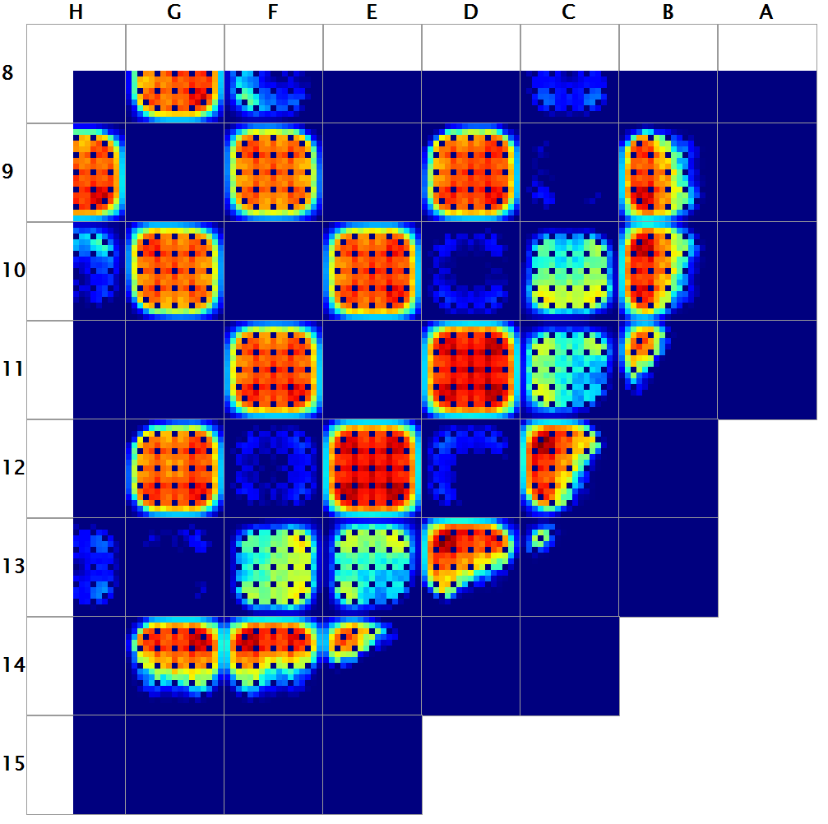
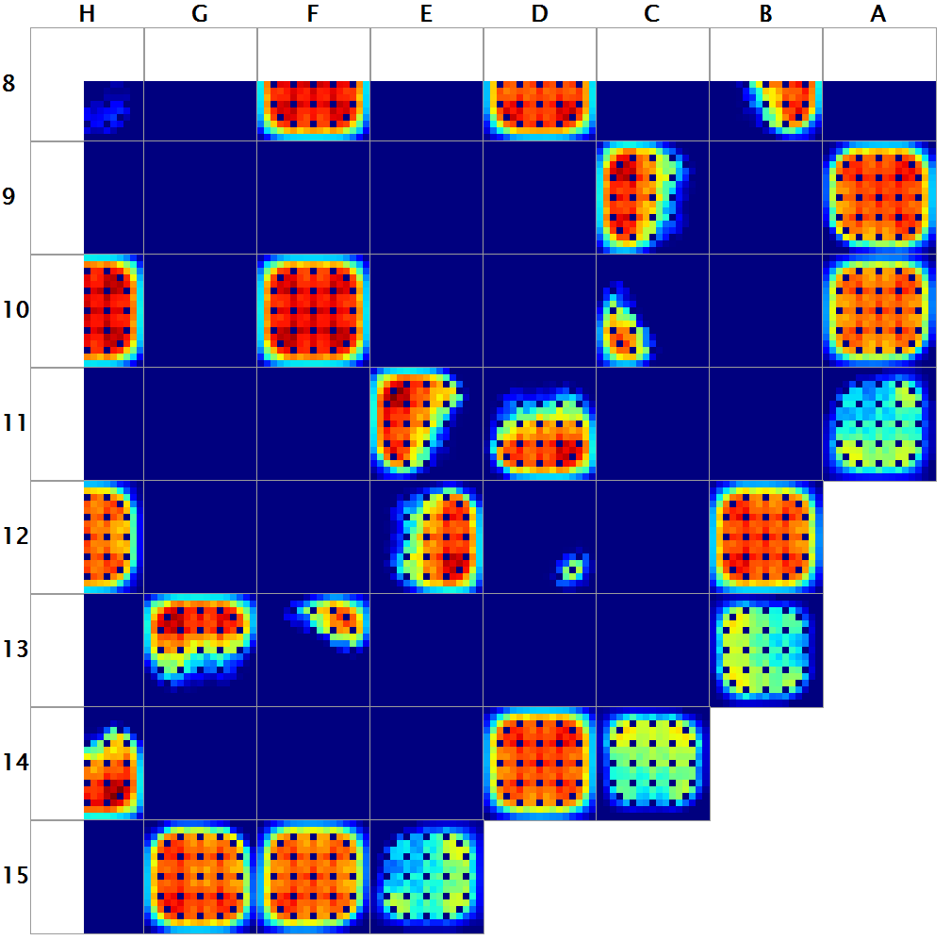
CRUD Shuffling and Cleaning Exercise
Shuffles assemblies with crud carryover after cleaning
Restart file contains crud mass for every surface on every rod at EOC
Allow for the optimization of ultrasonic cleaning between cycles
Seabrook EOC 4
Seabrook BOC 5

Slide 16
CRUD Shuffle Exercise
CAVEAT!
These models are optimized for speed and to show explicit CRUD effects. Many of the values for the inputs in these models are non-normal!
Make sure you are in your home directory
cd ~/session5/shuffle/

Slide 17
CRUD Shuffling and Cleaning Input
path-to-restart-file restart state name
[STATE]
restart_shuffle ../cips_smr/cips_smr.res EOC
shuffle_label
+ P-3 N-2 K-2
N-6 N-1 N-3 +
K-3 M-3 N-3
P-2 +
crud_cleaning
- 0.6 - -
0.6 - 0.6 -
- 0.6 -
- -
crud_removal 0.1
[CORE]
cycle 2
op_date 2019/03/14
Open shuffle.inp and add/change the following inputs:
map of shuffled
assemblies from prior
depleted cycles
map of assemblies with
individual crud cleaning
fractions applied
each entry is fraction
of crud thickness removed
**What do you think?
generic cleaning applied
to all assemblies
date must be later than op_date on restart file

Slide 18
CIPS Capabilities in VERAView
Learn to:
Open and manage multiple files
Create and visualize a difference dataset (AO and pin_powers)

Slide 19
Thank You!

Slide 20
Extra Slides

